Slide 1


FYP-I
Recruit Right: Precision Hiring with AI Insight
Team Member Muhammad Naeemuddin
Muhammad Abdullah
Muhammad Raza Supervisor Dr. Umer Farooq
Department of Computing, FEST
Hamdard University

Slide 2
Table of Contents
Problem Statement
Proposed Solution
Objective
Scope
Methodology
Key Features
Overview & Impact
Diagrams
GUI Design
Challenge & Risks
Future Enhancements
FYP-I Deliverables
Conclusion
References

Slide 3
Problem Statement
“Inefficiencies in Manual Technical Hiring Processes Hindering Growth”
A growing logistics company is facing significant challenges with its manual technical hiring process, leading to:
Prolonged hiring timelines
Interview coordination issues
Inconsistent candidate assessments
High turnover rates
Increased operational costs
To improve efficiency, reduce time-to-hire, and enhance the quality of hires, the company needs an automated hiring solution.

Slide 4
Proposed solution
Standardized Assessments & Virtual Interview Integration
Streamlined Scheduling
Feedbacks
Provide interviewers with pre-designed evaluation forms.
Automatically generate and share meeting links for interviews.
Automated Resume Screening:
Use NER to match resumes with job descriptions and filter candidates.
Automate interview slot management and integrate with calendars.
Deliver detailed, data-driven reports for quicker decisions.
01
03
02
04

Slide 5
Objective
Use expert interviewers for tailored assessments.
Offer scalable, flexible solutions.
Enhance candidate experience with a seamless platform.
2
4
6
1
3
5
7
Streamline hiring with managed technical interviews.
Ensure fairness with standardized formats.
Deliver data-driven post-interview insights.
Speed up hiring through efficient processes

Slide 6
Scope
This project focuses on addressing inefficiencies in traditional technical hiring processes, such as prolonged timelines, inconsistent candidate evaluations, and high operational costs. By leveraging automation and expert collaboration, the proposed platform aims to:
Analyze Hiring Challenges: Conduct an in-depth study of current hiring practices to identify pain points and inefficiencies in resume screening, interview processes, and candidate evaluations.
Offer an Automated Solution: Develop a scalable platform that integrates resume screening using NER tools, facilitates seamless interview scheduling, and ensures objective candidate assessments through collaboration with pre-vetted expert interviewers.
Design a Comprehensive System: Create a system that generates detailed, data-driven post-interview reports, enhancing decision-making for hiring teams while providing a smooth and transparent experience for candidates.
The platform will cater to businesses of all sizes, helping them reduce time-to-hire, improve recruitment efficiency, and support organizational growth through streamlined technical hiring.

Slide 7
Key Features
Features
Standardized Assessments:
Pre-designed forms ensure consistent evaluations.
Comprehensive Reporting:
Detailed feedback for data-driven decisions.
User-Friendly Interface:
Intuitive design for seamless navigation.
Key Features
Customizable Interview Plans:
Tailored workflows with expert guidance.
Automated Resume Screening:
NER-based candidate filtering.
Skilled Interviewer Network:
Access to qualified Interview Engineers.
Streamlined Scheduling:
Automated slot management and calendar integration.
Online Interview Integration:
Automatic meeting link generation.
Key

Slide 8
Overview and Impact
Target Users:
Organizations hiring efficiently.
Candidates seeking transparent processes.
Interview Engineers conducting evaluations.
Technologies Used:
Front-End: HTML, CSS, JavaScript, Bootstrap.
Back-End: Python
Database: Firebase
AI: NER for resume screening ( FYP-II )
Benefits:
Faster hiring with automation.
Consistent and unbiased assessments.
Cost-effective and scalable.

Slide 9
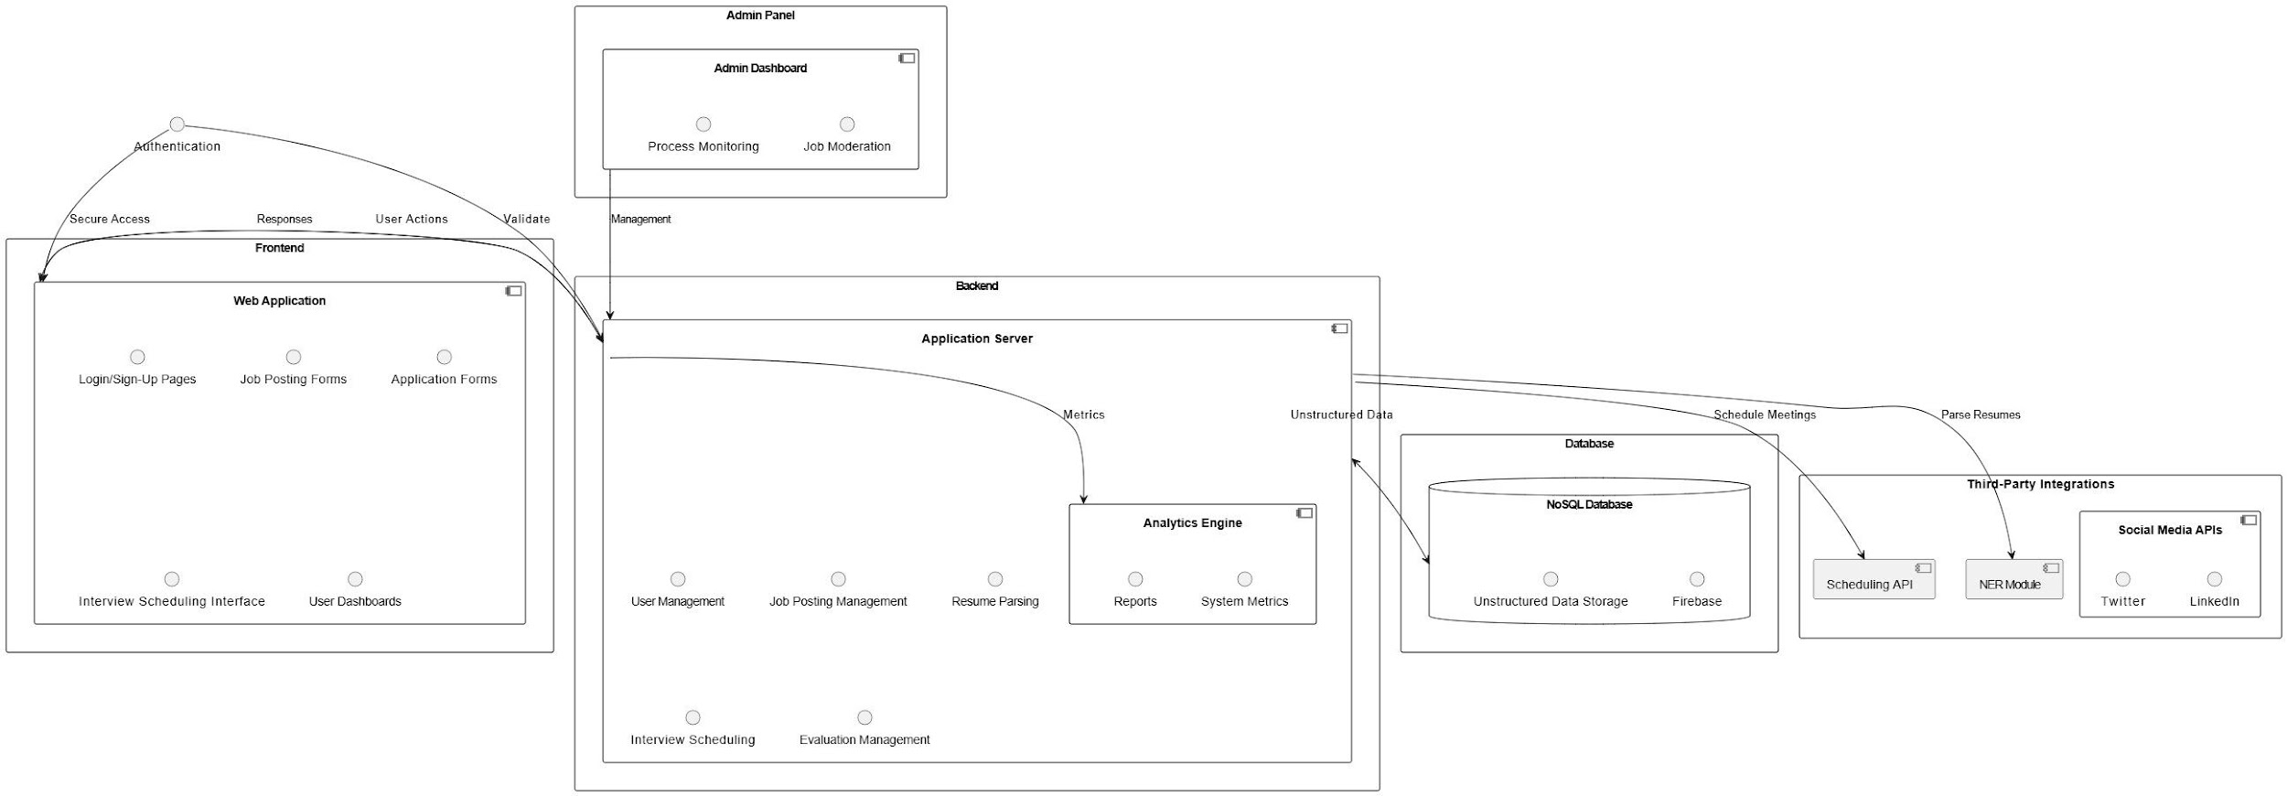
System Architecture Diagram

Slide 10
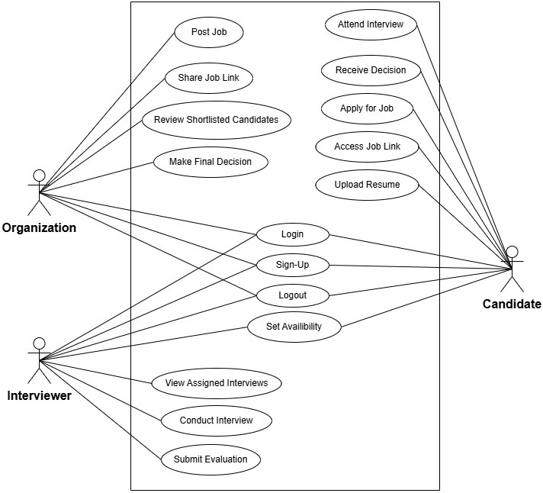
Use Case Diagram

Slide 11
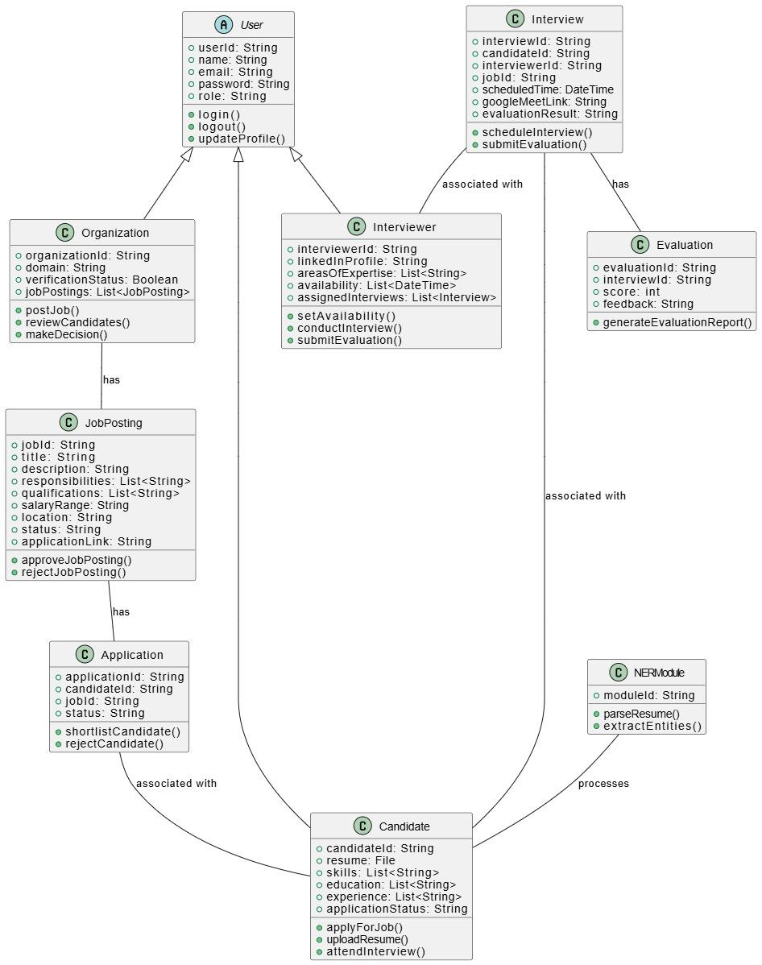
Class Diagram

Slide 12
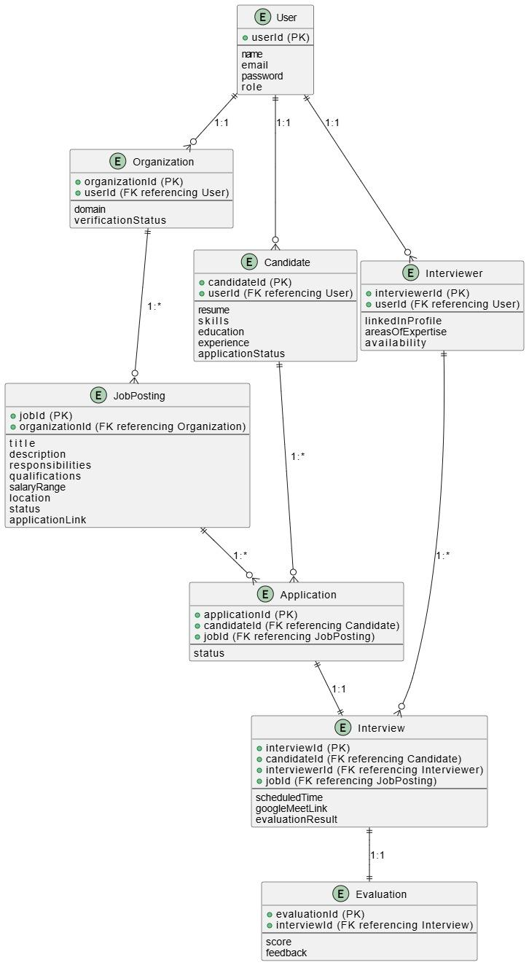
ER Diagram

Slide 13
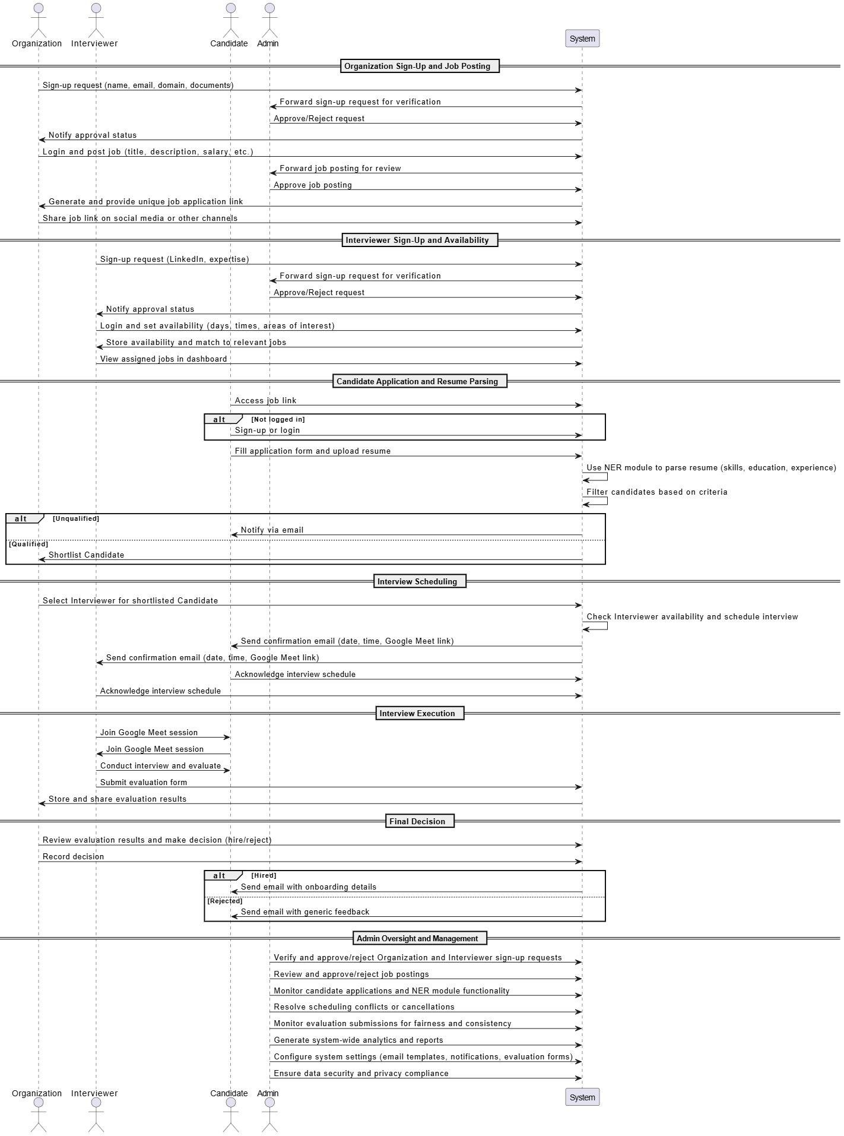
Sequence Diagram

Slide 14
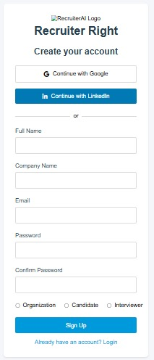
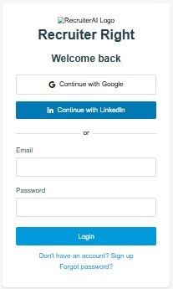
GUI Design

Slide 15
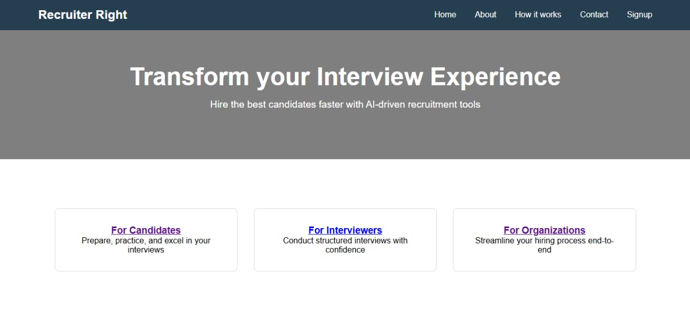
GUI Design

Slide 16
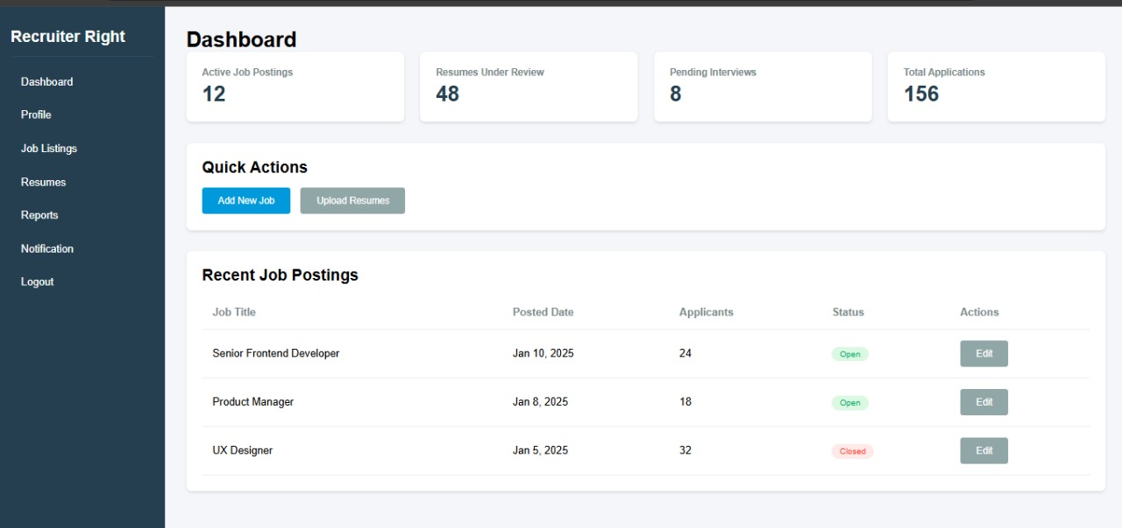
GUI Design

Slide 17
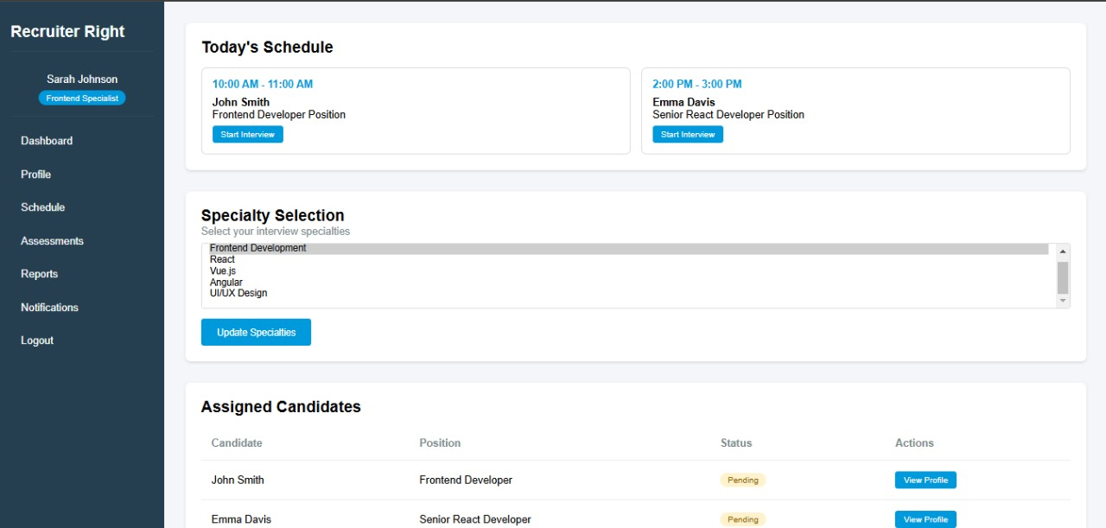
GUI Design

Slide 18
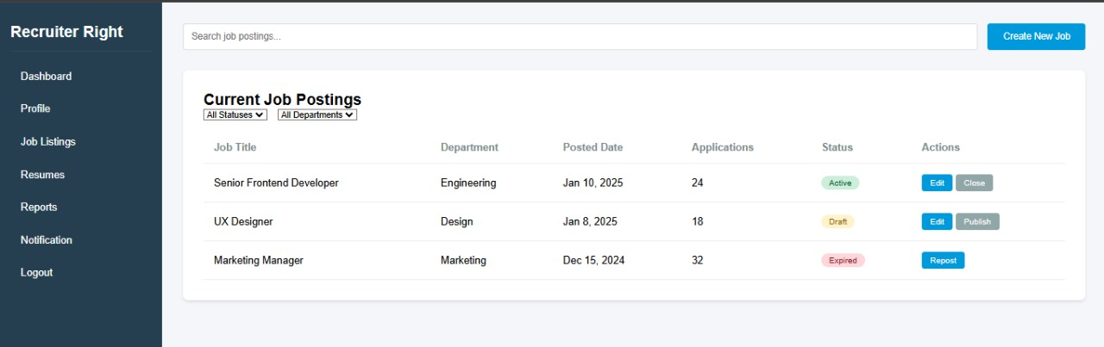
GUI Design

Slide 19
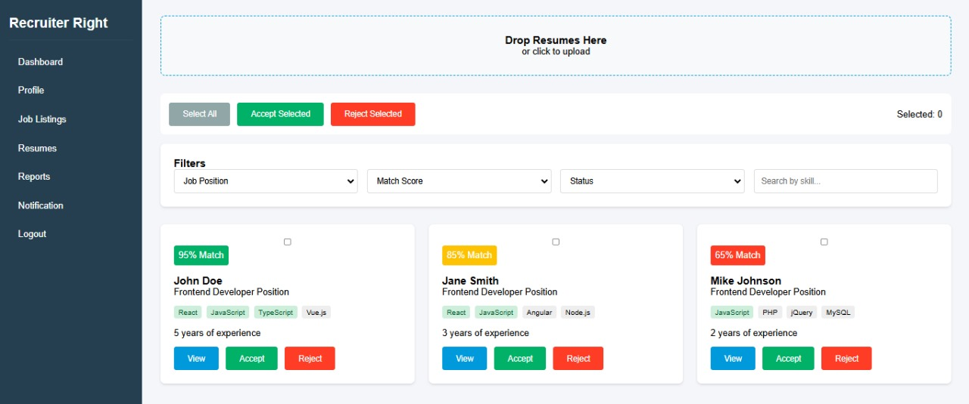
GUI Design

Slide 20
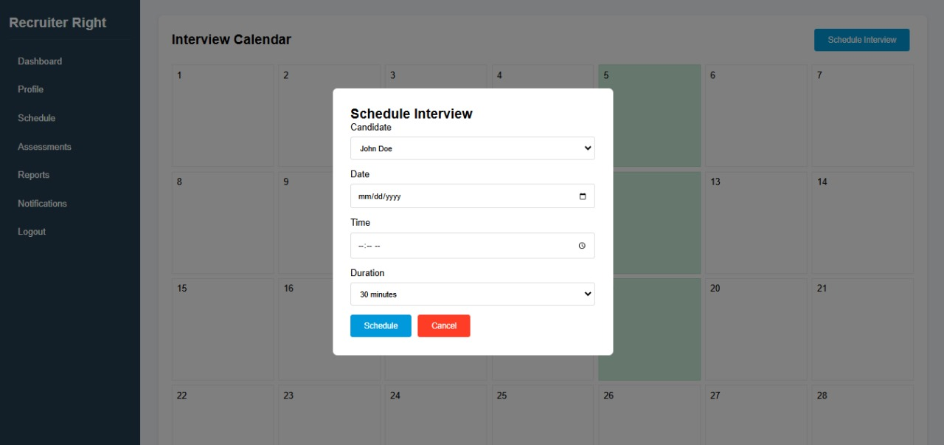
GUI Design

Slide 21
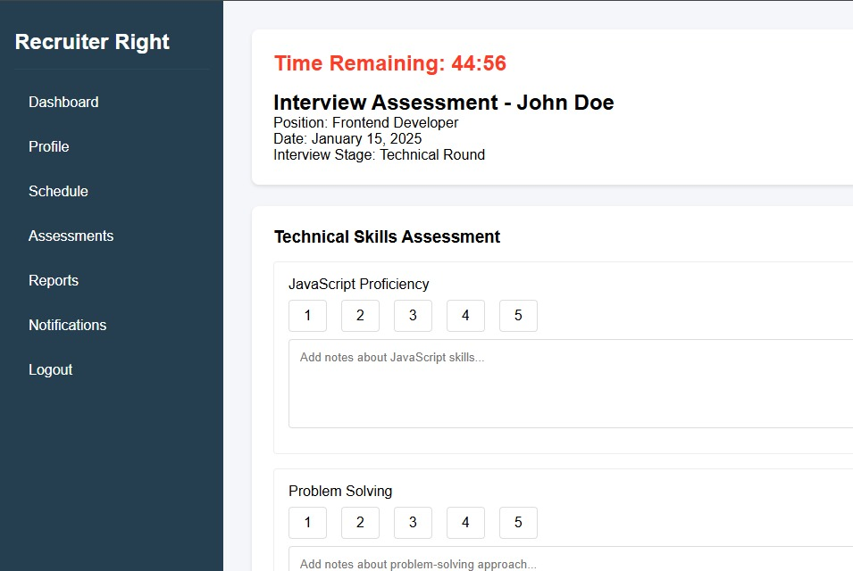
GUI Design

Slide 22
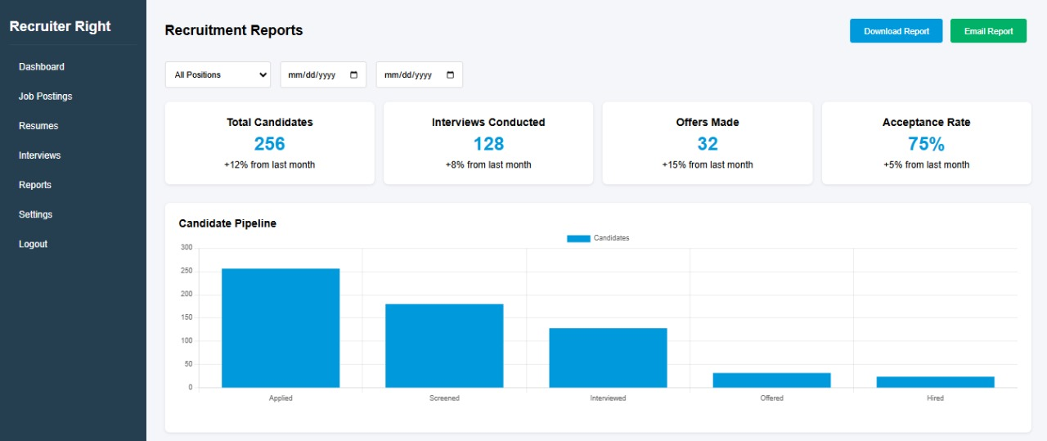
GUI Design

Slide 23
Challenges and Risks
Achieving accurate NER results.
Encouraging user adoption of the platform.
Managing scalability for growing users.
Seamless integration with third-party tools.
Avoiding technical glitches and AI biases.
Adhering to regulations and compliance.
Controlling costs and maintaining the system.

Slide 24
Future Enhancements
AI-Powered Skill Matching:
Advanced AI for deeper alignment between resumes and job roles.
Video Interview Analytics:
AI-based analysis of candidate responses and behavior in interviews.
Integration with ATS:
Seamless integration with Applicant Tracking Systems.
Advanced Reporting:
Real-time analytics and predictive insights for hiring trends.

Slide 25
Conclusion
Streamlines Hiring Process: Automates key tasks like resume screening, scheduling, and candidate evaluation, reducing time-to-hire.
AI-Driven Assessments: Ensures consistent, unbiased, and accurate hiring decisions through standardized workflows.
Scalable and Flexible Design: Adapts to growing demands and diverse recruitment needs.
User-Centric Interface: Simplifies navigation for organizations, candidates, and interviewers, enhancing the experience for all stakeholders.
Cost-Effective Solution: Minimizes manual effort and operational inefficiencies, improving overall hiring outcomes.

Slide 26
FYP Deliverables
Project Plan
SRS Document
SDS Document
Software Plan & WBS
Design Mockup
Project Report – I

Slide 27
Reference
[1] Internet Web page: Author. “karat”. https://karat.com/.
[2] Internet Web page: Author. “intervue.io”. https://www.intervue.io/.
[3] Mehboob, Muntaha & Ali, Saad & ul Islam, Saif & Ali, Syed. (2022). Evaluating Automatic CV Shortlisting Tool For Job Recruitment Based On Machine Learning Techniques. 1-4. 10.1109/MAJICC56935.2022.9994112.
[4] G O, Narendra & S., Hashwanth. (2022). Named Entity Recognition based Resume Parser and Summarizer. 2581-9429. 10.48175/IJARSCT-3029.

Slide 28
GitHub Repository
https://github.com/bluevit/FYP-029-FL24---Recruit-Right

Slide 29
Thank You!

